Slide 1
Recruitment and Selection

Slide 2
Purpose and Importance
Determine the present and future requirements of the firm in conjunction with its personnel planning and job-analysis
Increase the pool of job candidates at minimum cost
Help increase the success rate of the selection process by reducing the number of visibly under-qualified or overqualified job applicants
Reduce the probability that job applicants, once recruited and selected, will leave the organization only after a short period of time
Meet the organization’s legal and social obligations regarding the composition of its workforce
Begin identifying and preparing potential job applicants who will be appropriate candidates

Slide 3
Increase organizational and individual effectiveness in the short term and long term
Evaluate the effectiveness of various recruiting techniques and sources for all types of job applicants

Slide 4
A recruiting programme helps the firm in at least four ways:
Attract highly qualified and competent people
Ensure that the selected candidates stay longer with the company
Make sure that there is match between cost and benefit
Help the firm create more culturally diverse workforce

Slide 5
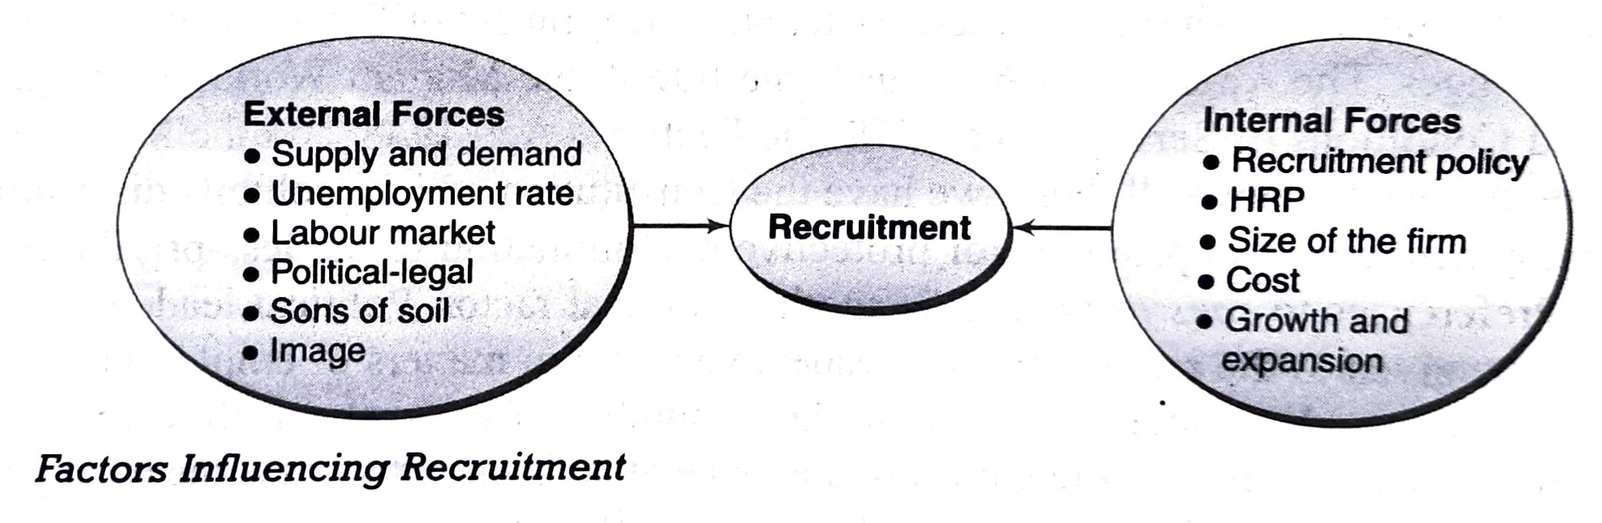

Slide 6
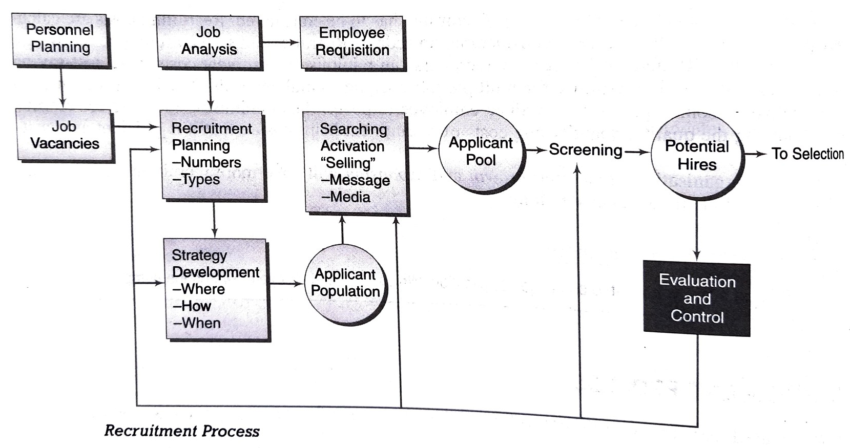

Slide 7
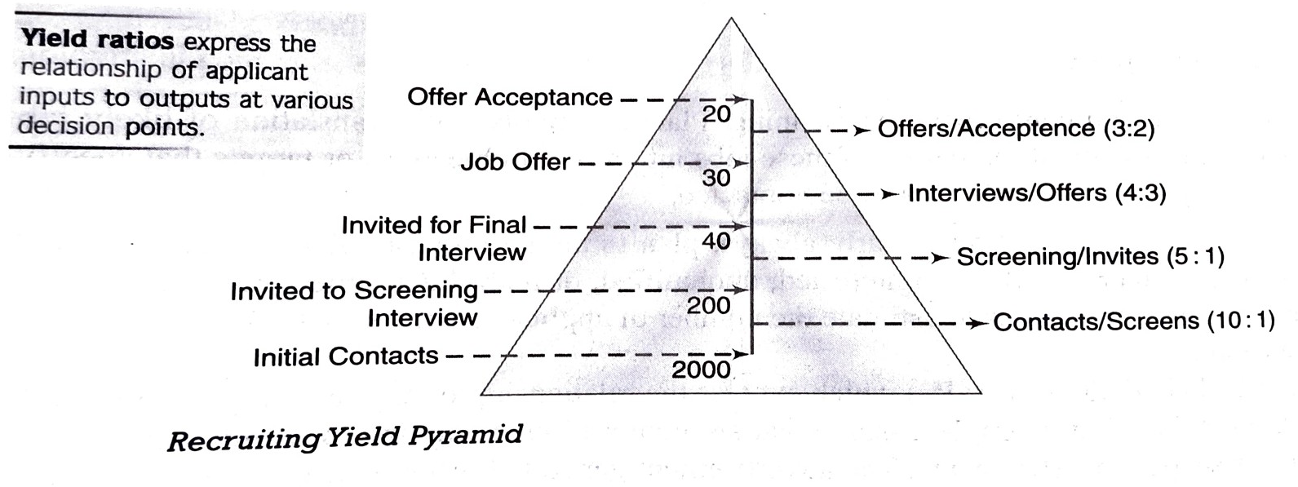

Slide 8
